Slide 1
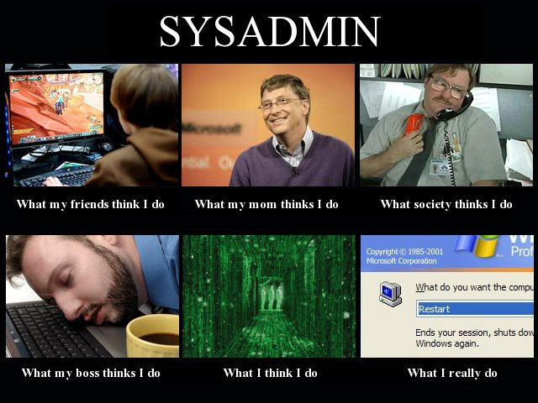
Introduction to System Administration
GIC 2022
The Job of a SysAdmin

Slide 2
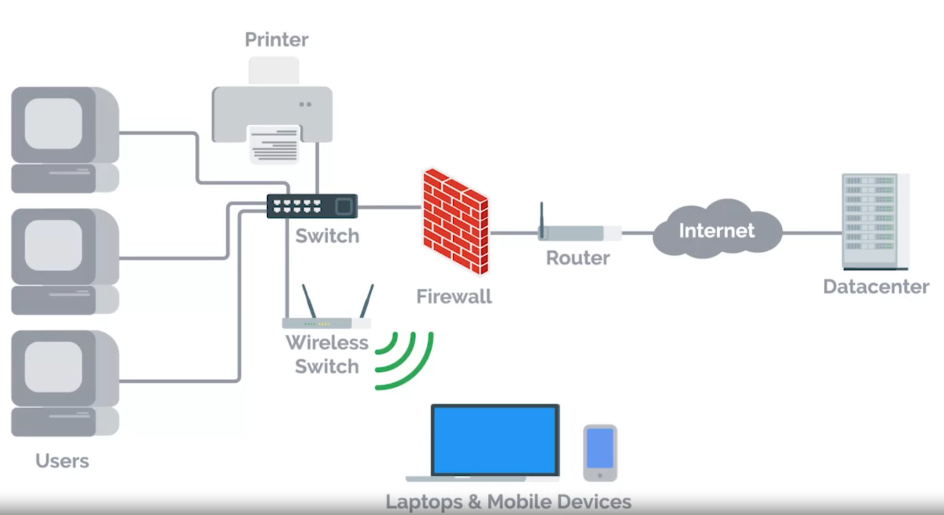
What is System Administration?
What is a system or IT infrastructure?

Slide 3

What is System Administration?
SysAdmins are superheroes.

Slide 4
What is System Administration?
A sysadmin is responsible for their company’s IT services like email, file storage, website running, …etc.
Where are these stored?
: email server, web server, …etc.
Servers!

Slide 5
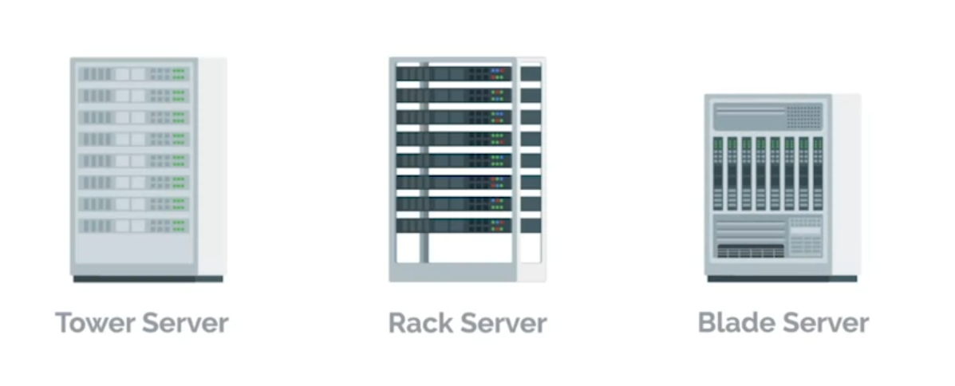
What is System Administration?
Server hardware: Tower, Rack, Blade…

Slide 6
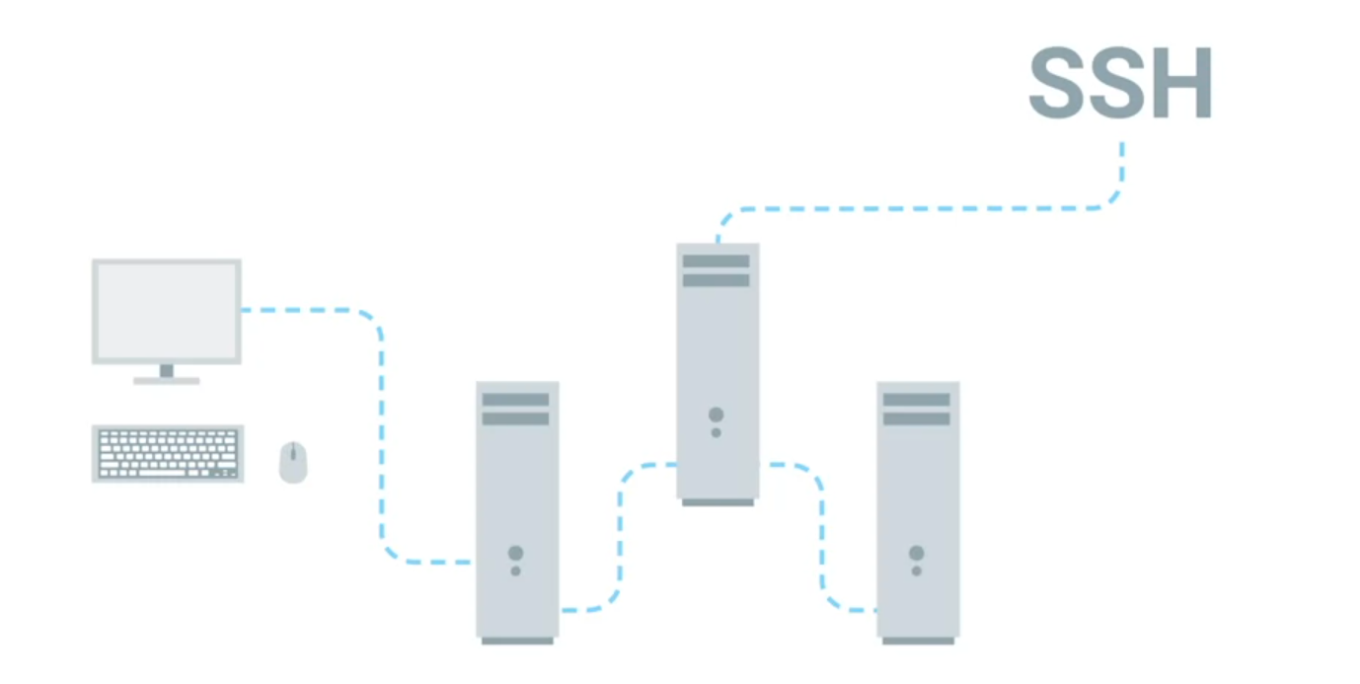
What is System Administration?

Slide 7
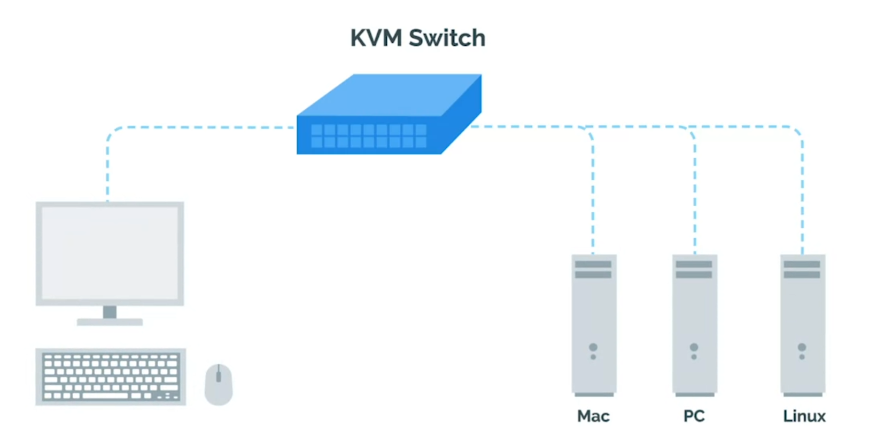
What is System Administration?

Slide 8
Systems Adminstration Tasks
Organization Policies:
Should users be allowed to install software?
Should users have complex passwords with certain requirements?
Should users be allowed to view non-work-related websites, like Fb?
Good Documentation! ( of policies )

Slide 9
Systems Adminstration Tasks
User management:
Manage user accounts, adding new or removing one.
Users should be able to use necessary software.
Hardware Provision:
When it was built? When it was first used? Brand new or used? Who maintained it before? How many have used it?

Slide 10
Systems Adminstration Tasks
Hardware Lifecycle:
Procurement
Deployment
Maintenance
Retirement

Slide 11
Systems Adminstration Tasks
Routine Maintenance:
Regular update software
Batch Update ( ex: once a month )

Slide 12
The job of a System Administrator
Seriously, what does a sysadmin do?
No precise job description
Often learned by experience
Making things run
Work behind the scenes
Often known as IT Support, Operator, Network Admin, System Programmer, System Manager, Service Engineer, System Engineer,..etc.

Slide 13
The job of a System Administrator
System administrator (n.): one who, as a primary job function, manages computer and network systems on behalf of another, such as an employer of client
Computer-human systems consists of:
The computers
The network
The users
Organizations policies and goals.

Slide 14
Next session
A little more about sysadmin responsibility
System design strategies
Network and Infrastructure Services

